Slide 1

Stereo Vision The Correspondence Problem
John Morris
Iolanthe returns to the Waitemata Harbour
Notes:
Good afternoon and thank you everyone for coming.
My talk today will describe the research I performed at the IRIS at USC, the object of this work being to build a computational framework that addresses the problem of motion analysis and interpretation.

Slide 2
Correspondence Problem
Methods for establishing correspondences
Two issues
How to select candidate matches?
How to determine the goodness of a match?
Two main classes of correspondence (matching) algorithm:
Correlation-based
Attempt to establish a correspondence by matching image intensities – usually over a window of pixels in each image
Dense disparity maps
Distance is found for all BV image points
Except occluded (MV) points
Feature-based
Attempt to establish a correspondence by matching a sparse sets of image features – usually edges
Disparity map is sparse
Number of points is related to the number of image features identified

Slide 3
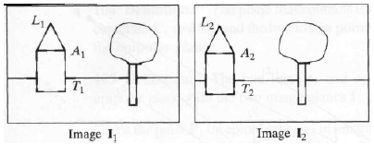
Feature-Based Methods
Main idea
Look for a feature in an image that matches a feature in the other.
Typical features used are:
edge points
line segments
corners (junctions)

Slide 4

Feature-Based Methods
A set of features is used for matching
a line feature descriptor, for example, could contain:
length, l
orientation, θ
coordinates of the midpoint, m
average intensity along the line, i
Similarity measures are based on matching feature descriptors:
where w₀, ..., w₃ are weights
(determining the weights that yield the best matches is a nontrivial task).

Slide 5
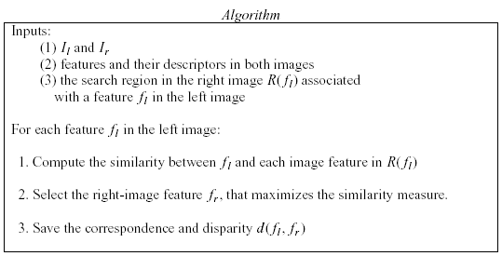
Feature-Based Methods

Slide 6
Correlation vs. feature-based approaches
Correlation methods
Easier to implement
Provide a dense disparity map (useful for reconstructing surfaces)
Need textured images to work well (many false matches otherwise)
Don’t work well when viewpoints are very different, due to
change in illumination direction
violates Lambertian scattering assumption
foreshortening
perspective problem – surfaces are not fronto-planar
Feature-based methods
Suitable when good features can be extracted from the scene
Faster than correlation-based methods
Provide sparse disparity maps
OK for applications like visual navigation
Relatively insensitive to illumination changes

Slide 7
Feature-based Methods
Matching is difficult!
Selecting features should make it easier?
but
Correlation techniques have received more attention
Possible reasons
Feature detection is sensitive to noise
Features ‘appear’ to have quite different geometries
Lengths, local curvatures differ
Edges easily split into two or more edges
Feature area altered by perspective
Failure of the fronto-planar assumption
Texture on flat surfaces generates unnecessary features
…

Slide 8
Correlation Matching
Fundamental algorithm
Canonical configuration (⏐⏐ image planes, ⏐⏐ optical axes)
Search along scan lines
d = x_{L} - x_{R}
Problem
How do we find the ‘best’ match?
For each pixel in one image (the reference image) Find best match (best correlation) in the other image Use the disparity, d, to determine depth, Z
Z ∝ 1/d

Slide 9
Real images are noisy!
Signal noise arising from
electromagnetic interference (eg cross-talk),
quantum behaviour of electronic devices (eg resistor shot-noise) and
quantization noise from digitizing real-valued analogue signals
Geometric sources
Discrete pixel sensors with finite area,
Occlusions,
Perspective distortion
Electronic sources
intensity sensitivity variations between cameras (eg different optical or electronic gain settings),
different `dark noise' levels
Optical sources
non-uniform scattering (non-Lambertian surfaces),
reflections and specular highlights,
angle dependent colour scattering (`grating' effects),
lighting variation due to different view angles

Slide 10
Noise in Stereo Matching
Signal noise
Common to almost all electronic measurement equipment and introduce random perturbations to measured image intensities
Geometric sources
Arise from the internal structure of digital cameras themselves and the stereo system configuration.
Electronic sources
Some configurations avoid this noise by using a single camera on a translation base or a moving scene (eg object on a rotation stage).
Optical sources
The physical separation of the two cameras results in different viewing angles for the scene and produces this group of problems, caused by assumptions usually made by matching algorithms - all surfaces are perfect Lambertian scatterers.

Slide 11
Solutions – Average the Noise
Window-based Correlation Algorithms
Compare a window of pixels in one image with a window of pixels in the other
Noise averages itself out over the window
d=Δ
d=0
Reference Image
Move an identical window along the epipolar line
In the other image looking for the best match
Disparity, d, varies from
0 ( Z = ∞ ) to
( Z = min )
where min is determined by system configuration – closest approach of an object

Slide 12
Correlation-Based Methods

Slide 13
Correlation-Based Methods
Basic Algorithm
Assume rectified images in canonical configuration
Epipolar lines aligned with scan lines
or
Conjugate pairs lie in corresponding scan lines
for each row, k
for j = Δ to w
c_{min} = ∞
for d = 0 to Δ // check each possible disparity
c(d) = f ( I₁(j,k), I₂(j-d,k) )
if c(d) < c_{min} then
d_{best} = d
c_{min} = c(d)
disp( j,k ) = d_{best} // Save best d value

Slide 14
Correlation-Based Methods
Cost function
Simplest
f ( I₁(j,k), I₂(j-d,k) ) = | I₁ (j,k) - I₂ (j-d,k) |
absolute difference
Generally a window of pixels around j,k will be considered f ( I₁(j,k), I₂(j-d,k) ) = Σ | I₁ (j+p,k+q) - I₂ (j+p-d,k+q) |
SAD takes random pixel noise into account well
Gain (contrast) and offset deviations may be partially taken into account by normalizing over the window ⇒
-w≤p≤+w
-w≤q≤+w
Sum of Absolute Differences (SAD)

Slide 15
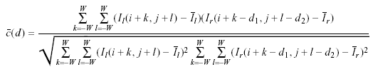

Correlation-Based Methods
Usually, we normalize c(d) by dividing it by the standard deviation of both I_{l} and I_{r} (normalized cross-correlation, c(d) ∈ [0,1])
where and are the average pixel values in the left and right windows.
An alternative similarity measure is the sum of squared differences (SSD):
But experiment shows that the simpler sum of absolute differences (SAD) is just as good for reasonable
c(d) = Σ Σ | I_{l}(i+k,j+l) – I_{r}(i+k-d,j+l) |

Slide 16
Correlation-Based Methods
Experiment shows that the simpler sum of absolute differences (SAD) is just as good for reasonable cameras (Gains and offsets matched)
Stereo matching is computationally expensive!
Correlation algorithms have time complexity O( h w Δ (win)² )
Even though the pixel comparison is simple and fast (absolute difference), for a medium resolution image (h = w = 10³), reasonable depth accuracy (1%, Δ > 100) and sufficiently large windows for good matching accuracy, win ≈ 10, h w Δ (win)² = 10³ × 10³ × 10² × 10 × 10 = 10¹⁰
The total number of operations required for a single image is quite large!
More complex cost functions – SSD, normalized correlation, etc – which involve more complex computation are often not justified!

Slide 17
Correlation-Based Methods
Comments
The success of correlation-based methods depends on whether the image window in one image exhibits a distinctive structure that occurs infrequently in the search region of the other image.
How to choose the size of the window, W?
too small a window
may not capture enough image structure and
may be too noise sensitive
many false matches
too large a window
makes matching less sensitive to noise (desired) but also
decreases precision (blurs disparity map)
An adaptive searching window has been proposed:
T Kanade and M Okutomi, A stereo matching algorithm with an adaptive window, IEEE Trans PAMI, 16(9), 920-932 (1994)

Slide 18
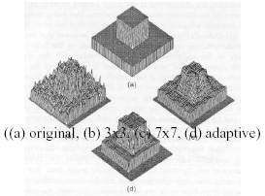
Correlation Methods – Adaptive Windows
Input – Ground truth
3x3 window
Too noisy!
7x7 window
Sharp edges are blurred!
Adaptive window
Sharp edges and less noise

Slide 19
Correlation-Based Methods
Improvements
Instead of using the image intensity values, the accuracy of correlation is improved by using thresholded signed gradient magnitudes at each pixel.
Compute the gradient magnitude at each pixel in the two images without smoothing
Map the gradient magnitude values into three values: -1, 0, 1 (by thresholding the gradient magnitude)
More sensitive correlations are produced this way
several dozen more see
D Scharstein & R Szeliski, Intl Journal of Computer Vision, 47(1), 7-42 (2001) for a review
This is quite an important paper: it classifies many of the approaches to stereo matching and provides an objective quantitative comparison of many algorithms!
The use of metrics to compare approaches appears to be quite rare in computer vision papers – another reason to read this one!!

Slide 20
Correlation-Based Methods
several dozen more see
D Scharstein & R Szeliski, Intl Journal of Computer Vision, 47(1), 7-42 (2001) for a review
This is quite an important paper: it classifies many of the approaches to stereo matching and provides an objective quantitative comparison of many algorithms!
The use of metrics to compare approaches appears to be quite rare in computer vision papers – another reason to read this one!!
Middlebury stereo pages
Daniel Scharstein, Middlebury College, Vermont
http://vision.middlebury.edu/stereo/
Comparisons of many stereo matching algorithms

Slide 21
Other correspondence algorithms
Dynamic programming (Gimel’farb)
Finds a ‘path’ through an image which provides the best (least-cost) match
Can allow for occlusions (Birchfield and Tomasi)
Generally provide better results than area-based correlation
Faster than correlation
Graph Cut (Zabih et al)
Seems to provide best results
Very slow, not suitable for real-time applications
Concurrent Stereo Matching
Examine all possible matches in parallel (Delmas, Gimel’farb, Morris, work in progress)
Uses a model of image noise instead of arbitrary weights in cost functions
Suitable for real-time parallel hardware implementation
Some of these will be considered in detail later

Slide 22
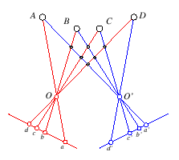
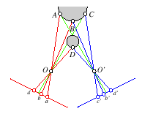
Ordering Constraint
If an object a is left on an object b in the left image then object a will also appear to the left of object b in the right image
Ordering constraint…
…and its failure

Slide 23
Correspondences
Left scanline
Right scanline
…
…
Match intensities sequentially between two scanlines

Slide 24
Correspondences
Left scanline
Right scanline
…
…
Match
Match
Left occlusion
Match
Right occlusion

Slide 25
Search Over Correspondences
Left Occluded Pixels
Left scanline
Right scanline
Right occluded Pixels
Three cases:
Sequential – cost of match
Left occluded – cost of no match
Right occluded – cost of no match

Slide 26
Standard 3-move Dynamic Programming for Stereo
Left Occluded Pixels
Start
Left scanline
Dynamic programming yields the optimal path through grid. This is the best set of matches that satisfy the ordering constraint
Right scanline
Right occluded Pixels
End

Slide 27
Dynamic Programming
Efficient algorithm for solving sequential decision (optimal path) problems.
i = 1
1
1
1
1
…
i = 2
2
2
2
2
i = 3
3
3
3
3
t = 1
t = 2
t = 3
t = T
How many paths through this trellis?
3^{T}

Slide 28
Dynamic Programming
i = 1
1
1
1
States:
i = 2
2
2
2
i = 3
3
3
3
Suppose cost can be decomposed into stages:

Slide 29
Dynamic Programming
1
1
1
2
2
2
3
3
3
Principle of Optimality for an n-stage assignment problem

Slide 30
Dynamic Programming
Keep a record of the predecessor of each node
1
1
1
2
2
2
3
3
3

Slide 31
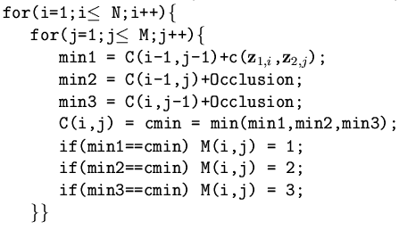
Stereo Matching with Dynamic Programming
Pseudo-code for calculating the optimal match
M(i,j) : predecessors

Slide 32
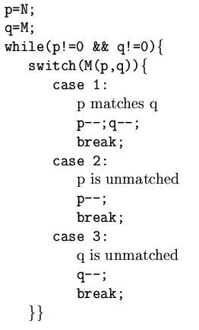
Stereo Matching with Dynamic Programming
Pseudo-code for reconstructing the optimal path
Occlusions –
Skip until next match is found

Slide 33
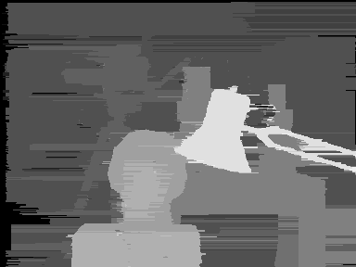
Dynamic Programming - Result
Local errors may be propagated along a scan-line:
no inter scan-line consistency is enforced

Slide 34
Graph cut
One of the best algorithms
S Roy, I J Cox, A maximum-flow formulation of N-camera stereo correspondence problem, Int Jnl Computer Vision, 34(2), 147-161(1998)
Y Boykov, O Veksler, R Zabih, Fast approximate energy minimization via graph cuts, IEEE Trans PAMI, 23(11), 1222-1239 (2001)
Produces high correct match scores
Global
Computationally expensive

Slide 35

Stereo As a Pixel-Labeling Problem
Let P be a set of pixels, L be a label set. The goal is find a labeling f which minimize some energy. For stereo, the labels are disparities.
The classic form of energy function is:
Data term
Smoothness term

Slide 36
Energy Function:
The energy function measures how appropriate a label is for the pixel p given the observed data. In stereo, this term corresponds to the match cost or likelihood.
The energy term encodes the prior or smoothness constraint. In stereo, the so called Potts model is used:

Slide 37
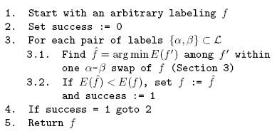
Two Energy Minimization Algorithm via Graph Cuts
Swap algorithm

Slide 38
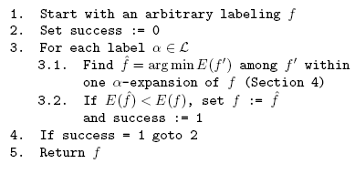
Two Energy Minimization Algorithm via Graph Cuts
expansion algorithm

Slide 39
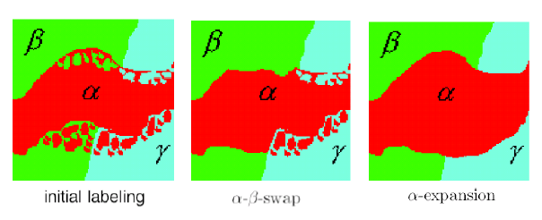
Moves

Slide 40
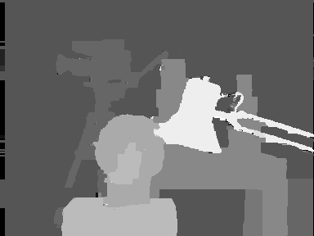
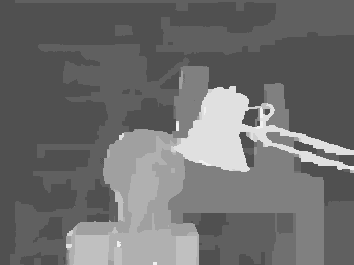
Graph Cuts Results
Graph Cuts
Belief Propagation

Slide 41
End of this section!

Slide 42
Epipolar Geometry
Significance of the epipolar lines
For an arbitrary stereo configuration, for each point (or window) in one image, you would need to search the whole of the other image for a match!
Very inefficient algorithm!
O(n⁴)
?
n
Left Image
Right Image

Slide 43
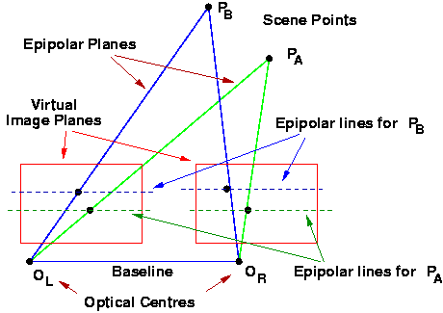
Epipolar Geometry
‘Canonical’ configuration
Optical axes, image planes & scan-lines parallel
Only necessary to search along scan lines
Corresponding point must lie on the same scan line in the other image
Simple (trivial) formulae for determining
Where to search
Same y coord
How to convert disparity to distance
Z ∝ 1 / d

Slide 44
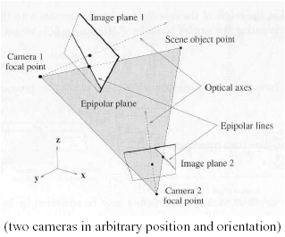
Epipolar Geometry
General configuration
Optical axes verge on ‘fixation point’ in scene
Only necessary to search along epipolar lines
Corresponding point must lie on the corresponding epipolar line in the other image
More complex formulae
Where to search
Slope of epipolar line is a function of image coordinates
Distance from disparity
Z = f( x, y, d )

Slide 45
Epipolar Geometry
Neat demonstration!
http://www.ai.sri.com/~luong/research/Meta3DViewer/EpipolarGeo.html
Note the
Epipoles
Intersections of the baseline with the image planes
Fixed positions
At infinity in the canonical configuration
All the epipolar lines for one camera go through its epipole
Epipolar Constraint
Corresponding points must lie on pairs of epipolar lines
Trucco refers to them as ‘conjugated epipolar lines’

Slide 46
Assumptions and constraints
Epipolar constraint
Corresponding points lie on corresponding epipolar lines
Holds for images if
Distortions are removed
ie Cameras conform to pin-hole model
In the canonical configuration (|| optical axes, image planes)
Epipolar lines are scan lines
Simple software!
Rectification often used to transform images to canonical configuration
Images rotated and translated to a new view
Requires estimation of the fundamental matrix

Slide 47
Assumptions and constraints
Uniqueness constraint
Each pixel in the reference image corresponds to at most one pixel in the other image
Potential violations
Quantization of images into pixels
Corresponding ‘pixel’ actually spreads over several pixels
Reflections

Slide 48
Assumptions and constraints
Continuity constraint
Surfaces are generally continuous
Disparity differences between neighbouring pixels less than a threshhold
If x^{L}₁ matches x^{R}₁ and
neighbouring pixel, x^{L}₂ matches x^{R}₂
|| x^{L}₁ – x^{R}₁| - | x^{L}₂ – x^{R}₂|| < th
Potential violations
Sharp edges
Only a small fraction of total image pixels
Can apply this constraint only in regions identified as belonging to one ‘object’ after segmentation

Slide 49
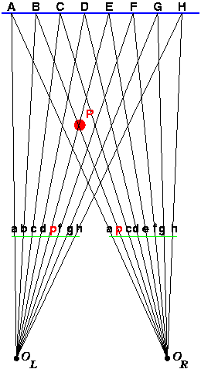
Constraints
Ordering constraint
Points on an epipolar line in one image appear on the corresponding epipolar line in the other image in the same order
Violations
Thin objects (‘poles’) well separated from a background
Note the ordering of image points (lower case) in the left and right images

Slide 50
Constraints
Intensity
Intensities of matching points are the same
Gain and offset of both cameras identical
No noise
Usually relaxed to
…… differ by a very small amount
Fronto-planar
Surface segments
Subtend the same angle or
Occupy the same number of pixels
in both images
Violations
Angled surfaces ⇨Perspective problem

